Slide 1
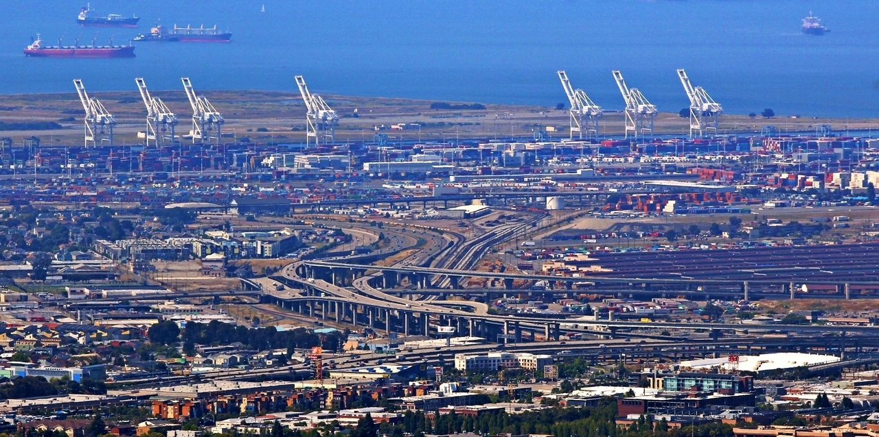
Data Science for Transportation
Dr. Greg Erhardt
261 OHR 859-699-1761 greg.erhardt@uky.edu

Slide 2

Why Data Science?

Slide 3
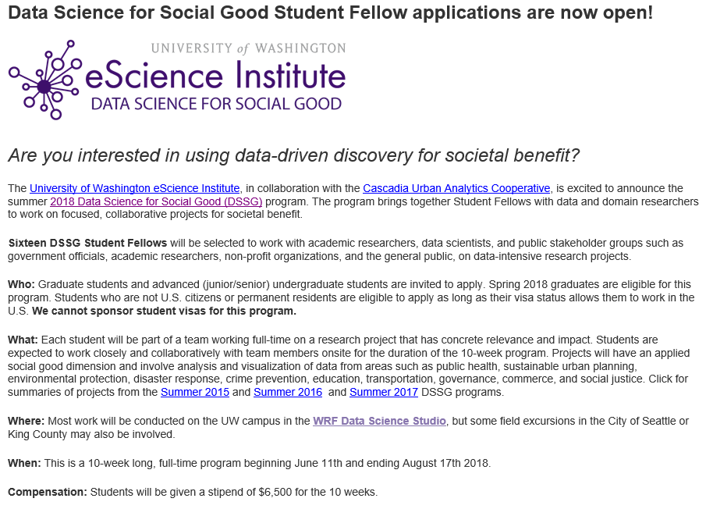
Why Data Science?
http://escience.washington.edu/dssg/

Slide 4
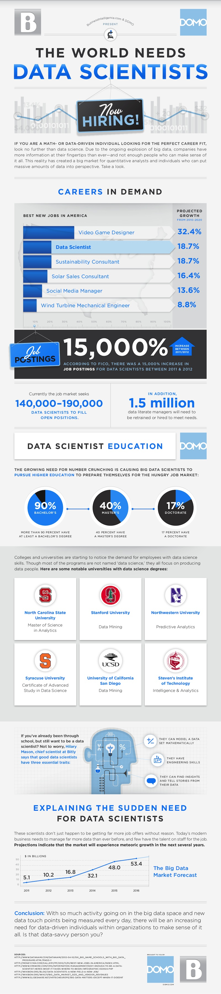
Why Data Science?
http://venturebeat.com/2013/11/11/data-scientists-needed/

Slide 5
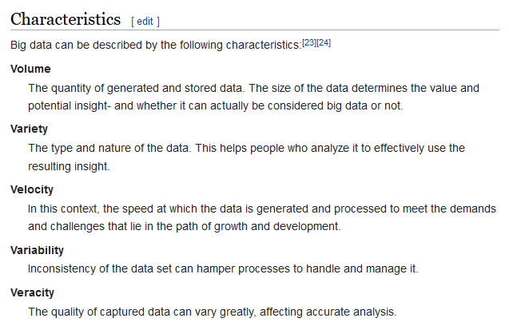
What is Big Data?

Slide 6
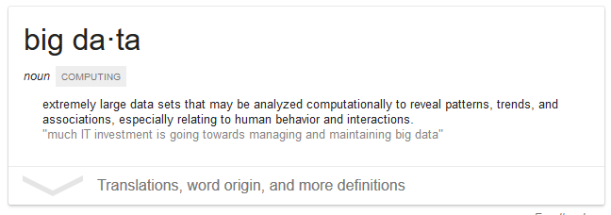
What is Big Data?

Slide 7
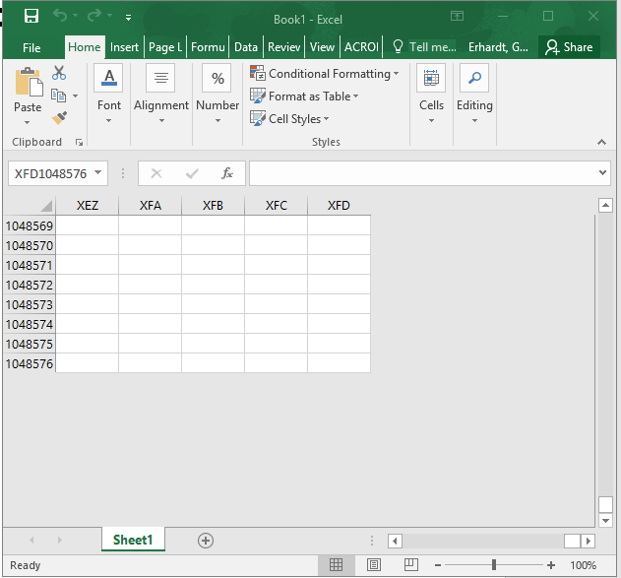
What is Big Data?
Anything that doesn’t fit in an Excel spreadsheet

Slide 8
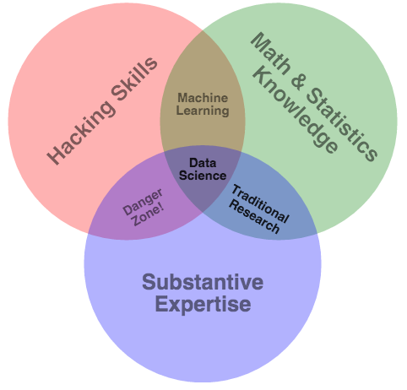
What is Data Science?
http://drewconway.com/zia/2013/3/26/the-data-science-venn-diagram.

Slide 10
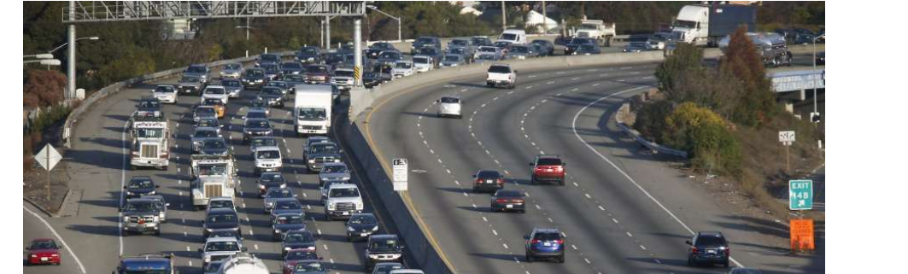
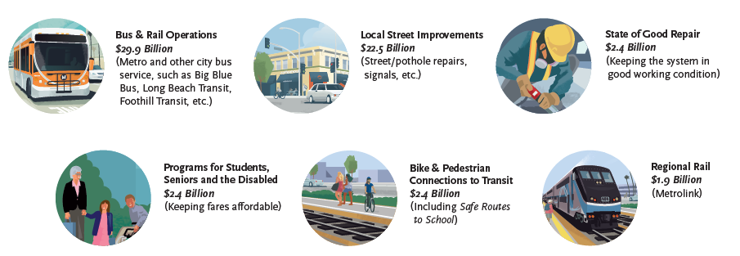
Why Transportation?

Slide 11
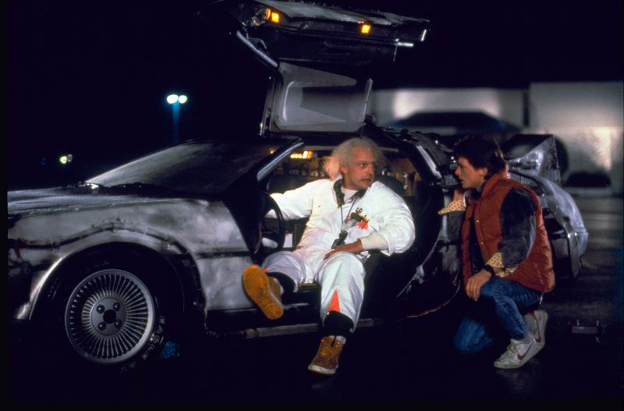
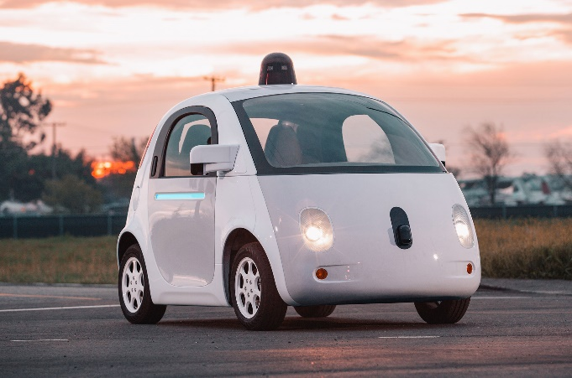
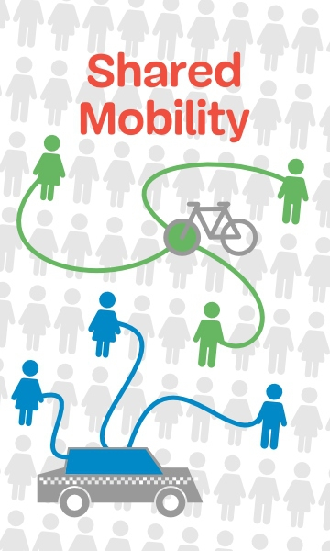

Why now?

Slide 12
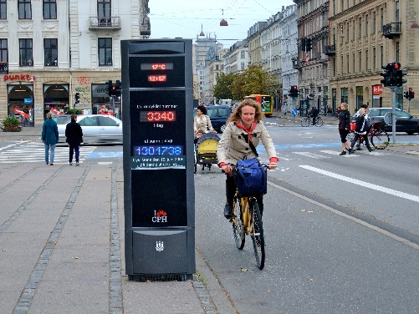
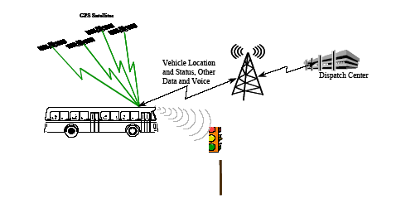
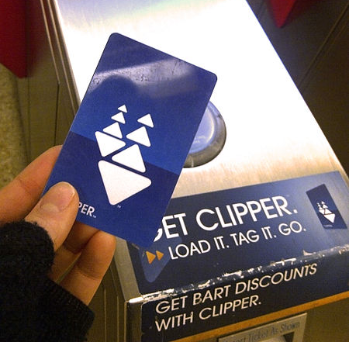
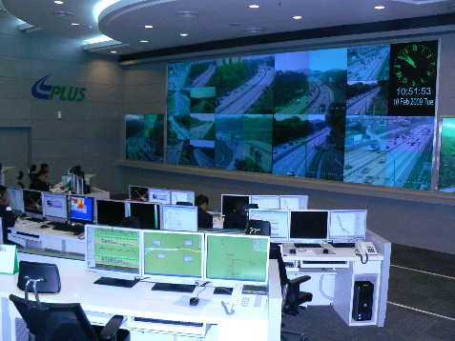
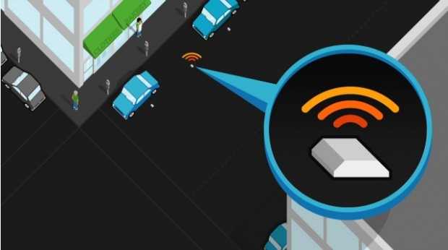
Increasingly, relevant and detailed data are being continuously collected, providing an opportunity to measure the changes that occur in the transport system.
Image from: wikipedia.com
Image from: appliedcomm.com
Image from: commons.wikimedia.org
Image from: commons.wikimedia.org
Image from: sfpark.org

Slide 13
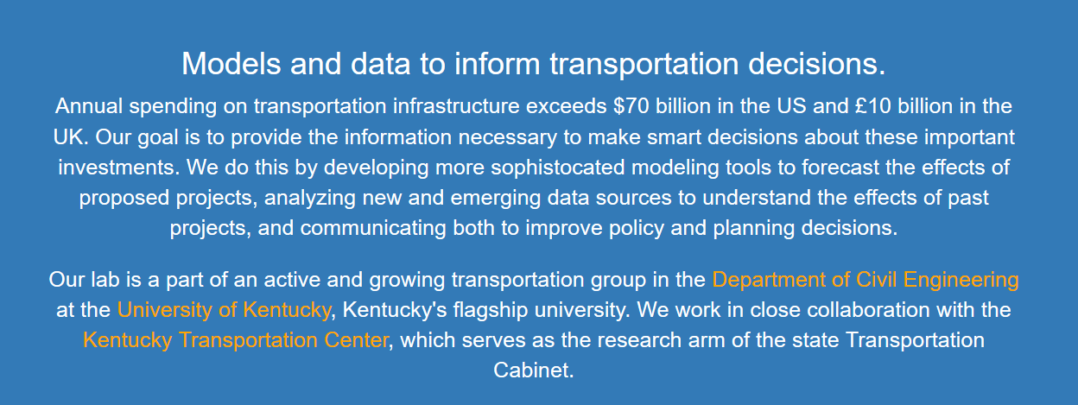

What I do…
What about you?

Slide 14

A note…
I’ve just given you a bunch of hype…
…can you separate the hype from the reality?

Slide 15
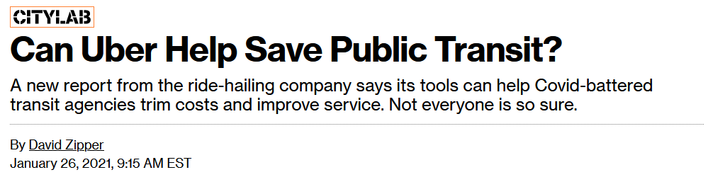

https://www.bloomberg.com/news/articles/2021-01-26/what-to-make-of-uber-s-bid-to-help-public-transit?srnd=citylab

Slide 16
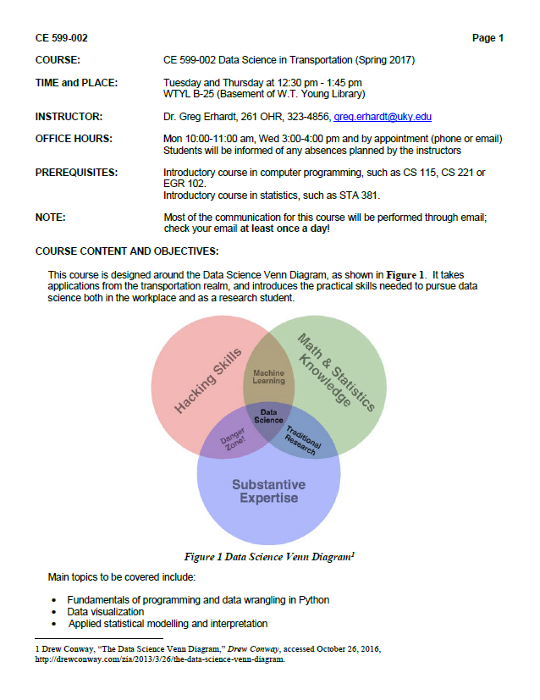
Syllabus & Expectations

Slide 17
Sources of Help
This is a “figure it out” class, not a “sit and listen” class!
Use these resources:
Class time
Text books, Libraries, Librarians
Dr. Google
Peers
Me
We won’t cover everything, but I hope you will start to learn how to “figure it out”

Slide 18
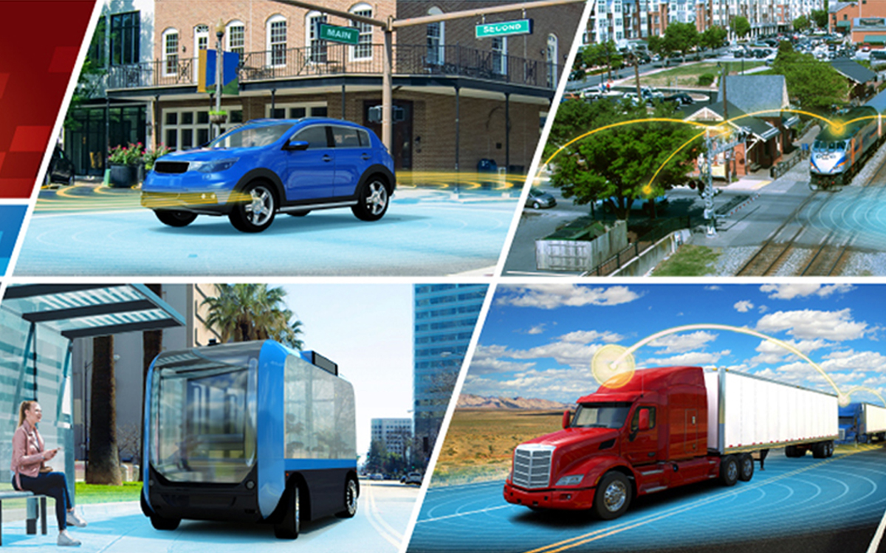
https://github.com/uky-transport-data-science/ce599
Let’s Get Started!

